Slide 1
A Simple Dynamic System Model of Plant Hydraulic Failure
ENV 764 Final Project
Shuyue Li

Slide 2
Background
Plants uptake water by root absorption while lose water by transpiration; thus, water flows from soil and through the xylem, eventually reaching to leaves
When transpiration increases compared to water supply, the leaf water potential reaches a more negative equilibrium, leading to water stress
High atmospheric vapor pressure deficit and low soil moisture usually occurs in dry conditions, which increase the water demand while decreasing the supply, due to lowered soil-to-root conductance and xylem cavitation
If drought last for enough time, it may eventually reduce the leaf water potential to the point of collapse - loss of a physiologically sustainable equilibrium
(Manzoni, Katul & Porporato, 2014)

Slide 3
Questions
What is plant hydraulic failure from a catastrophe theory perspective?
How do vapor pressure deficit (D) and soil moisture (equivalent to root water potential) trigger a state shift from one equilibrium point to another?

Slide 4
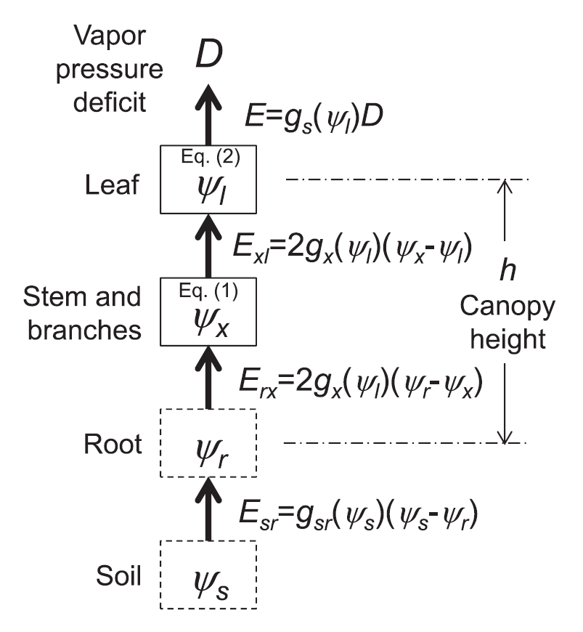

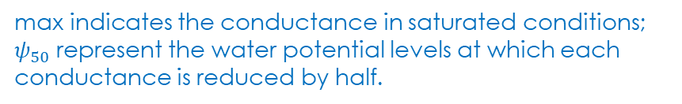



Previous Study
Mass balance equations for water storage:
Woody compartment:
$C_{x}\frac{ⅆψ_{x}}{ⅆt}=E_{rx}−E_{xl}=2g_{x}(ψ_{l})(ψ_{r}−{2ψ}_{x}$+ $ψ_{l}$)
Leaf compartment:
$C_{l}\frac{ⅆψ_{l}}{ⅆt}=E_{xl}−E=2g_{x}(ψ_{l})(ψ_{x}−$ $ψ_{l}$)- $g_{s}\left(ψ_{l}\right)D$
C is hydraulic capacitance
Linear assumptions (for analytical tractability):
$$g_{x}(ψ_{l})=g_{x,max}(1−\frac{1}{2}\frac{ψ_{l}}{ψ_{50,x}})$$
$$g_{s}(ψ_{l})=g_{s,max}(1−\frac{1}{2}\frac{ψ_{l}}{ψ_{50,s}})$$
Model scheme showing the water storage compartments (solid boxes), nodes (dashed boxes), and fluxes (arrows)
max indicates the conductance in saturated conditions; $ψ_{50}$represent the water potential levels at which each conductance is reduced by half.

Slide 5


Previous Study
Mass balance equations for water storage:
Woody compartment:
$C_{x}\frac{ⅆψ_{x}}{ⅆt}=E_{rx}−E_{xl}=2g_{x}(ψ_{l})(ψ_{r}−{2ψ}_{x}$+ $ψ_{l}$)
Leaf compartment:
$C_{l}\frac{ⅆψ_{l}}{ⅆt}=E_{xl}−E=2g_{x}(ψ_{l})(ψ_{x}−$ $ψ_{l}$)- $g_{s}\left(ψ_{l}\right)D$
A ‘safe’ plant: stomatal closure occurs at water potentials less negative than full cavitation, with convergence of the water potentials toward a single, stable equilibrium point
An ‘unsafe’ plant: stomatal closure is delayed with respect to cavitation occurrence, with a second unstable equilibrium point emerging -> saddle-node bifurcation

Slide 6
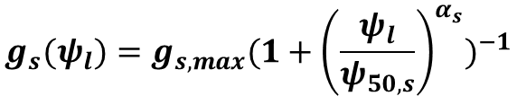
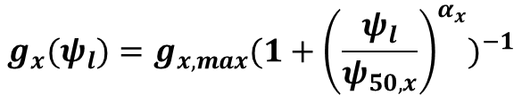
This project: change of linear assumptions
Mass balance equations for water storage:
Woody compartment:
$C_{x}\frac{ⅆψ_{x}}{ⅆt}=E_{rx}−E_{xl}=2g_{x}(ψ_{l})(ψ_{r}−{2ψ}_{x}$+ $ψ_{l}$)
Leaf compartment:
$C_{l}\frac{ⅆψ_{l}}{ⅆt}=E_{xl}−E=2g_{x}(ψ_{l})(ψ_{x}−$ $ψ_{l}$)- $g_{s}\left(ψ_{l}\right)D$
C is hydraulic capacitance
New assumptions:
$$g_{x}(ψ_{l})=g_{x,max}{(1+{\left(\frac{ψ_{l}}{ψ_{50,x}}\right)}^{α_{x}})}^{−1}$$
$$g_{s}(ψ_{l})=g_{s,max}{(1+{\left(\frac{ψ_{l}}{ψ_{50,s}}\right)}^{α_{s}})}^{−1}$$
g: conductance; 𝜓: water potential; E: water flux
Actually, cavitation curves and stomatal closure
curves often show a sigmoidal shape [Manzoni et al., 2013; Tuzet et al., 2003]

Slide 7

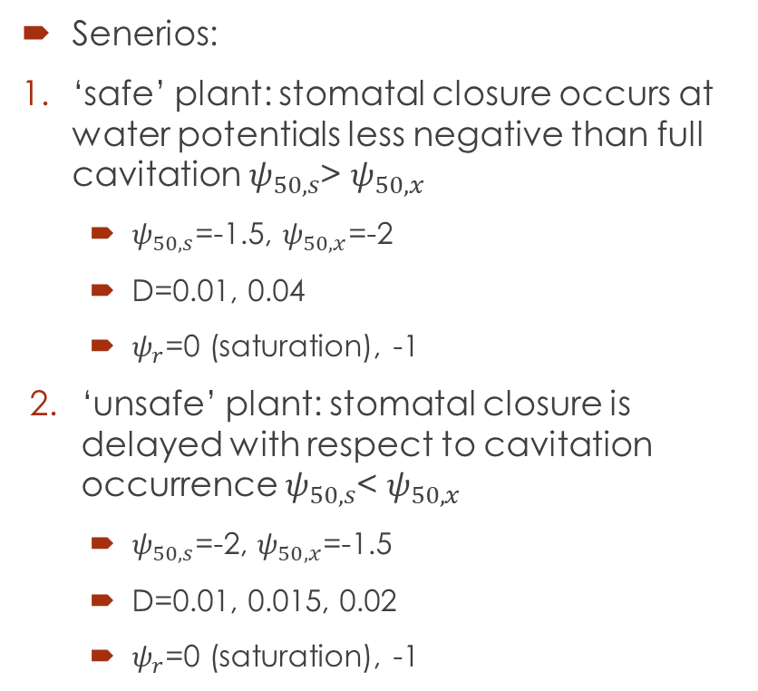

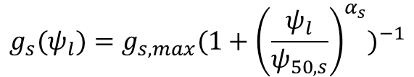
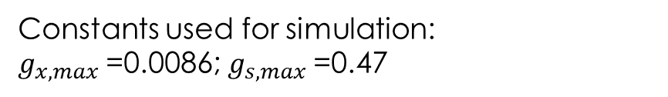
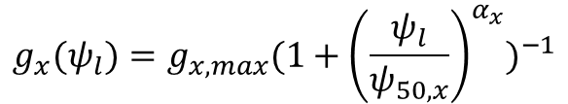
Methods
Mass balance equations for water storage:
Senerios:
‘safe’ plant: stomatal closure occurs at water potentials less negative than full cavitation $ψ_{50,s}$> $ψ_{50,x}$
$ψ_{50,s}$=-1.5, $ψ_{50,x}$=-2
D=0.01, 0.04
$ψ_{r}$=0 (saturation), -1
‘unsafe’ plant: stomatal closure is delayed with respect to cavitation occurrence $ψ_{50,s}$< $ψ_{50,x}$
$ψ_{50,s}$=-2, $ψ_{50,x}$=-1.5
D=0.01, 0.015, 0.02
$ψ_{r}$=0 (saturation), -1
Xylem
$C_{x}\frac{ⅆψ_{x}}{ⅆt}=E_{rx}−E_{xl}=2g_{x}(ψ_{l})(ψ_{r}−{2ψ}_{x}$+ $ψ_{l}$)
(1)
Leaf
$C_{l}\frac{ⅆψ_{l}}{ⅆt}=E_{xl}−E=2g_{x}(ψ_{l})(ψ_{x}−$ $ψ_{l}$)- $g_{s}\left(ψ_{l}\right)D$
(2)
$$g_{x}(ψ_{l})=g_{x,max}{(1+{\left(\frac{ψ_{l}}{ψ_{50,x}}\right)}^{α_{x}})}^{−1}$$
$$g_{s}(ψ_{l})=g_{s,max}{(1+{\left(\frac{ψ_{l}}{ψ_{50,s}}\right)}^{α_{s}})}^{−1}$$
Constants used for simulation:
$g_{x,max}$=0.0086; $g_{s,max}$=0.47

Slide 8
Results
‘safe’ plant
$ψ_{50,s}$=-1.5, $ψ_{50,x}$=-2, D=0.01, $ψ_{r}$=0
Blue dashed line: nullcline of (1);
Green solid curve: nullcline of (2);
Black thin curve: one numerical solution with initial value (-1.5, -1.5) using ode45
Blue dashed curve: evaporation demand
Red solid curve: water supply to leaves

Slide 9
Results
‘safe’ plant
$ψ_{50,s}$=-1.5, $ψ_{50,x}$=-2, D=0.04, $ψ_{r}$=0
Blue dashed line: nullcline of (1);
Green solid curve: nullcline of (2);
Black thin curve: one numerical solution with initial value (-1.5, -1.5) using ode45
Blue dashed curve: evaporation demand
Red solid curve: water supply to leaves

Slide 10
Results
‘safe’ plant
$ψ_{50,s}$=-1.5, $ψ_{50,x}$=-2, D=0.04, $ψ_{r}$=-1
Blue dashed line: nullcline of (1);
Green solid curve: nullcline of (2);
Black thin curve: one numerical solution with initial value (-1.5, -1.5) using ode45
Blue dashed curve: evaporation demand
Red solid curve: water supply to leaves

Slide 11
Results
‘unsafe’ plant
$ψ_{50,s}$=-2, $ψ_{50,x}$=-1.5, D=0.01, $ψ_{r}$=0
Blue dashed line: nullcline of (1);
Green solid curve: nullcline of (2);
Black thin curve: one numerical solution with initial value (-1.5, -1.5) using ode45
Blue dashed curve: evaporation demand
Red solid curve: water supply to leaves

Slide 12
Results
‘unsafe’ plant
$ψ_{50,s}$=-2, $ψ_{50,x}$=-1.5, D=0.015, $ψ_{r}$=0
Blue dashed line: nullcline of (1);
Green solid curve: nullcline of (2);
Black thin curve: one numerical solution with initial value (-1.5, -1.5) using ode45
Blue dashed curve: evaporation demand
Red solid curve: water supply to leaves

Slide 13
Results
‘unsafe’ plant
$ψ_{50,s}$=-2, $ψ_{50,x}$=-1.5, D=0.02, $ψ_{r}$=0
Blue dashed line: nullcline of (1);
Green solid curve: nullcline of (2);
Black thin curve: one numerical solution with initial value (-1.5, -1.5) using ode45
Blue dashed curve: evaporation demand
Red solid curve: water supply to leaves

Slide 14
Results
‘unsafe’ plant
$ψ_{50,s}$=-2, $ψ_{50,x}$=-1.5, D=0.015, $ψ_{r}$=-1
Blue dashed line: nullcline of (1);
Green solid curve: nullcline of (2);
Black thin curve: one numerical solution with initial value (-1.5, -1.5) using ode45
Blue dashed curve: evaporation demand
Red solid curve: water supply to leaves

Slide 15
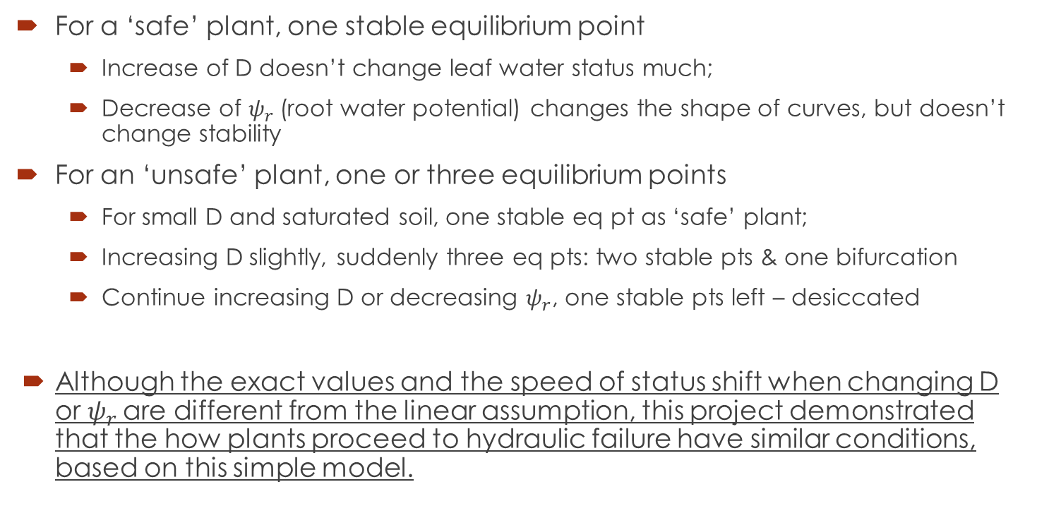
Summary
For a ‘safe’ plant, one stable equilibrium point
Increase of D doesn’t change leaf water status much;
Decrease of $ψ_{r}$(root water potential) changes the shape of curves, but doesn’t change stability
For an ‘unsafe’ plant, one or three equilibrium points
For small D and saturated soil, one stable eq pt as ‘safe’ plant;
Increasing D slightly, suddenly three eq pts: two stable pts & one bifurcation
Continue increasing D or decreasing $ψ_{r}$, one stable pts left – desiccated
Although the exact values and the speed of status shift when changing D or $ψ_{r}$are different from the linear assumption, this project demonstrated that the how plants proceed to hydraulic failure have similar conditions, based on this simple model.

Slide 16
Reference
Manzoni, S., G. Vico, G. Katul, S. Palmroth, R. B. Jackson, and A. Porporato (2013), Hydraulic limits on maximum plant transpiration and the origin of the safety-efficiency tradeoff, New Phytol., 198(1), 169–178.
Manzoni, S., Katul, G., & Porporato, A. (2014). A dynamical system perspective on plant hydraulic failure. Water Resources Research, 50(6), 5170-5183.
Tuzet, A., A. Perrier, and R. Leuning (2003), A coupled model of stomatal conductance, photosynthesis and transpiration, Plant Cell Environ., 26(7), 1097–1116.

